Slide 1
Capstone Project – 2 (supervised regression ) Bike Sharing Demand Prediction Individual Project: Ajit kumar patel

Slide 2
CONTENT
INTRO TO ML
SUPERVISED ML & TYPES
PROJECT DESCREPTION
PROBLEM STATEMENT
DATA SUMMARY
EDA OF DATA SET
BEFORE ML(regression) STEPS
Various ML(Regression) IMPLEMENTATION
CHALLENGES
CONCLUSION

Slide 3
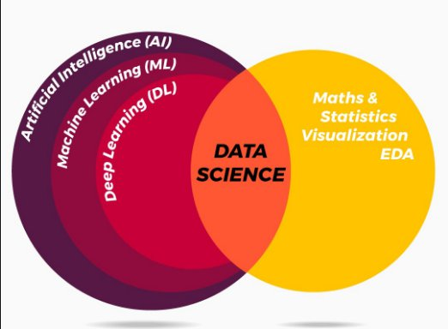
INTRO TO ML :
What is AI and how its help for ML problem
AI is the ability of a computer or a robot controlled by a computer to do a task that is usually done by humans because they required human intlegency &discernment.
ML/DL and DATA SCIENCE are the sub set of AI.
MACHNE LEARNING :
ML allows software application to become more accurate at predicating outcomes. With out being explicitly programmed to do so.ML algoritm used the historical data as input to predict new out put value.

Slide 4
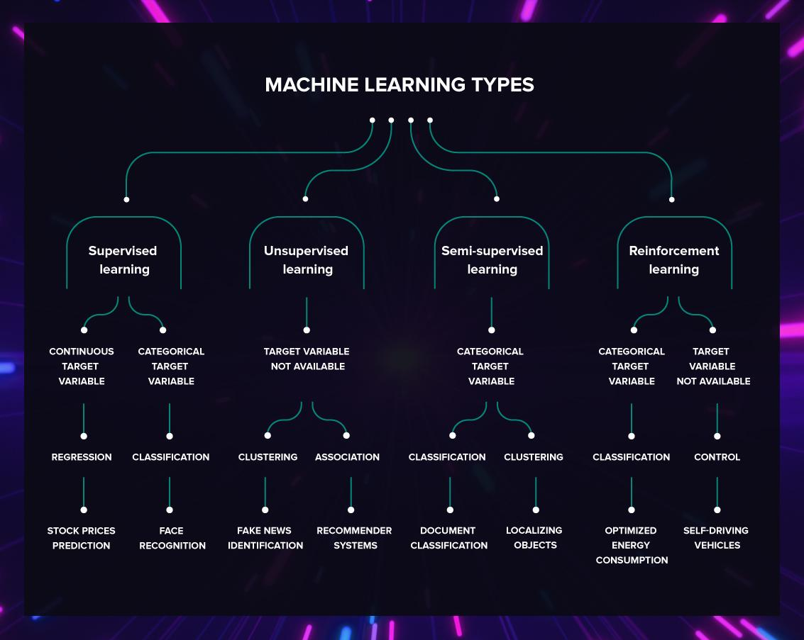
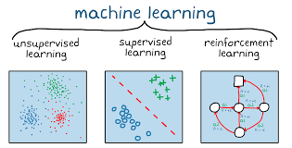
ML and it’s type :

Slide 5
Project description :
Currently Rental bikes are introduced in many urban cities for the enhancement of mobility comfort. It is important to make the rental bike available and accessible to the public at the right time as it lessens the waiting time. Eventually, providing the city with a
stablesupply of rental bikes becomes a major concern. The crucial part is the prediction of bike count required at each hour for the stable supply of rental bikes.

Slide 6


PROBLEM STATEMENT:
Prediction of bike count required at each hour.
Reduce waiting time of public .

Slide 7
Data summary
Date: Year-Month-Day
Rented Bike Count Count of bikes rented at each hour
Hour Hour of the day
Temperature - Temperature in Celsius
Humidity - %
Windspeed - m/s
Visibility-10m
Dew point temperature –Celsius
Solar radiation -MJ/m2
Rainfall -mmSnowfall-cm
Seasons-Winter, Spring, Summer, Autumn
Holiday -Holiday/No Holiday
Functional Day - NoFunc(Non Functional Hrs), Fun(Functional Hrs)

Slide 8
Basic eda:
The dataset has 8760 rows and 14 features(columns).
Three categorical features 'Seasons', 'Holiday', & 'Functioning Day’.
One Datetime[ns] features 'Date’.
Outliers present only in dependent variable.
No Missing Values.
No Duplicated values.
No null values.

Slide 9
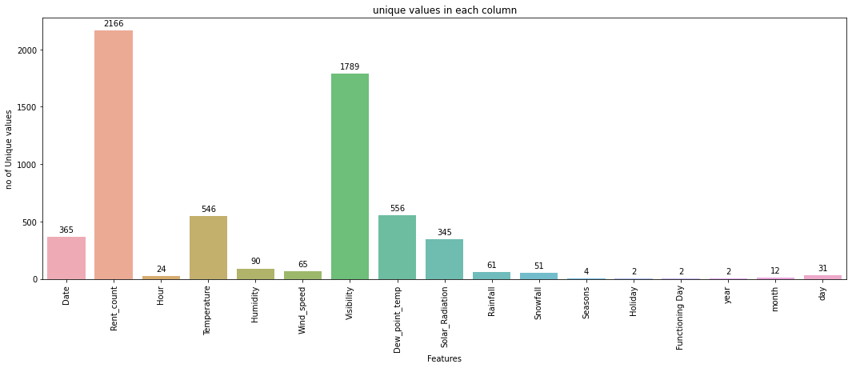
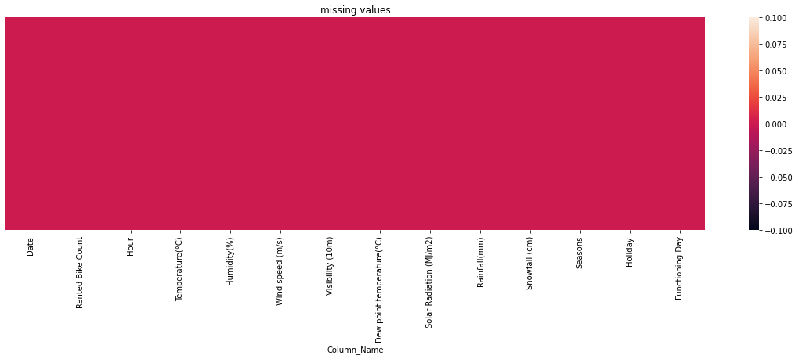
Counts of unique values : Null value inspection :

Slide 10
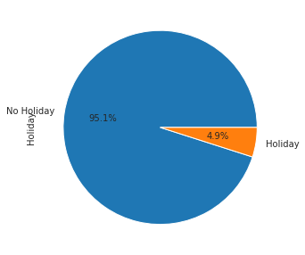
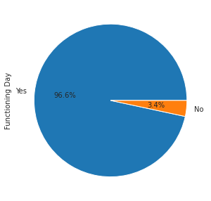
Counting the % of Functioning day & Holiday

Slide 11
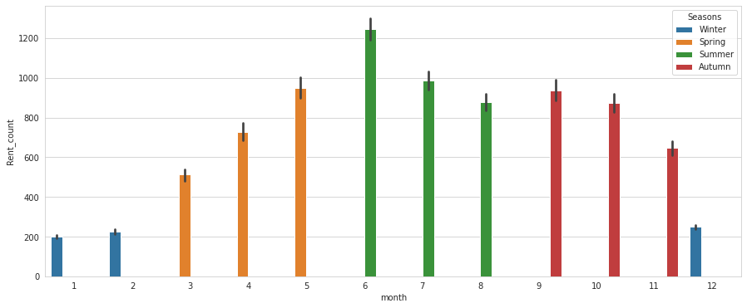
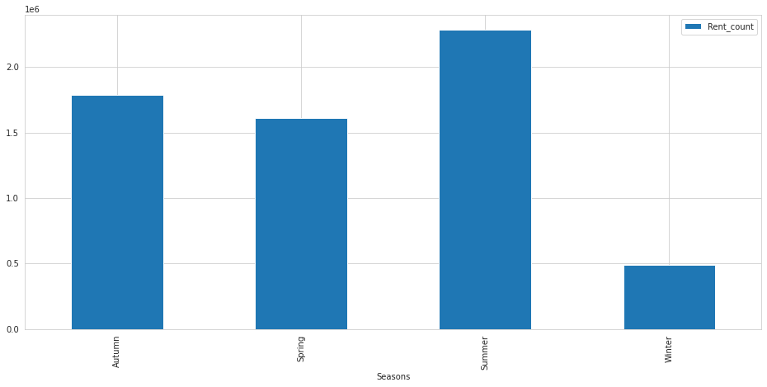
Rent_count ,monthly and Seasons Wise:

Slide 12
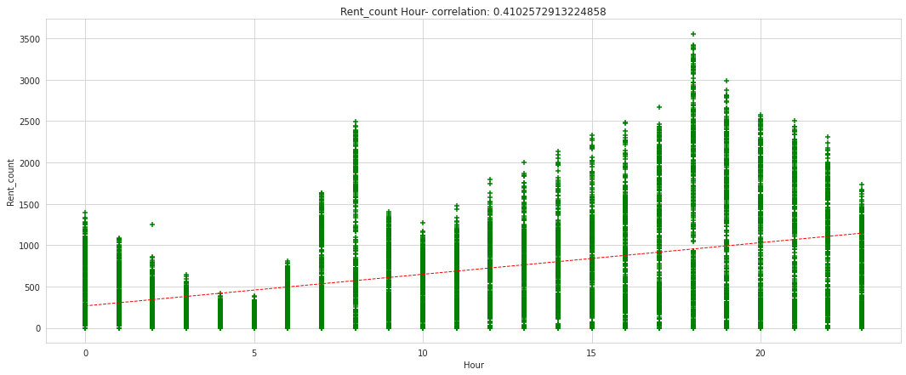
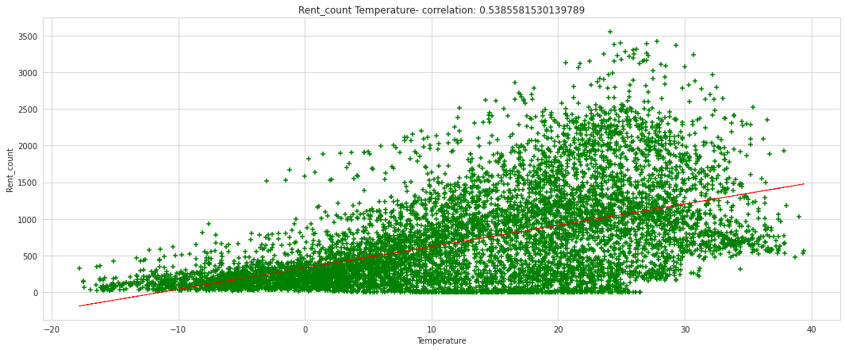
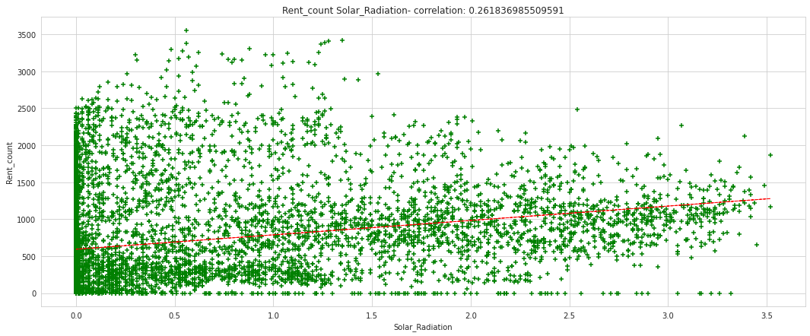
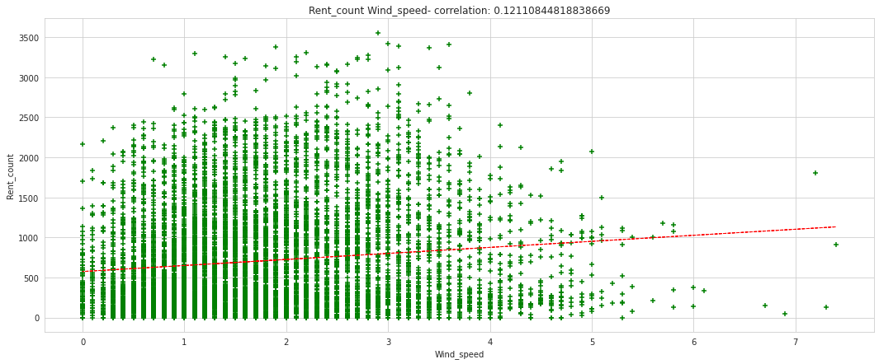
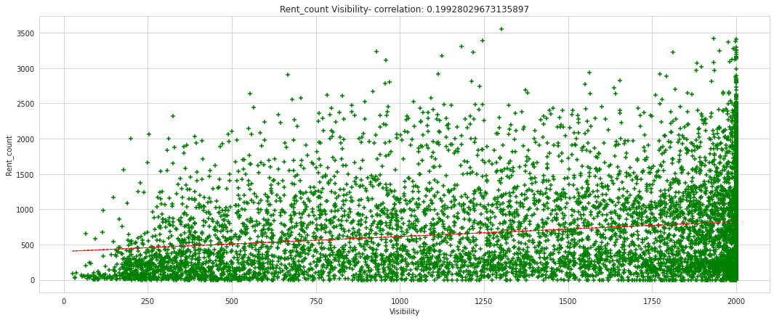
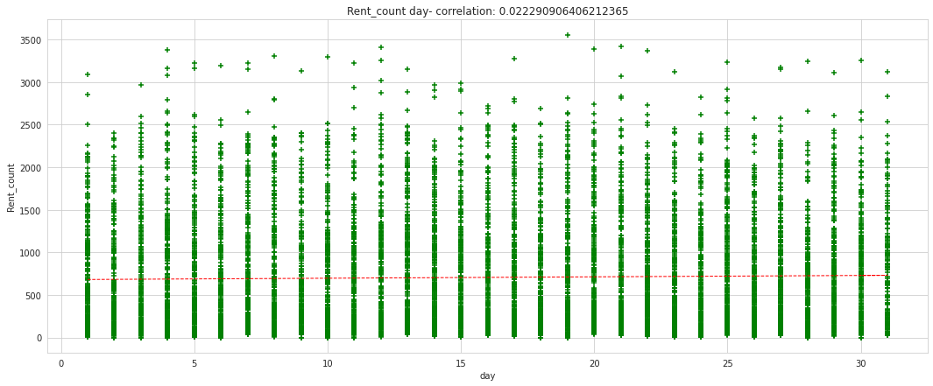
Assumption of regression line:(before model steps)
Finding the relation between the dependent and independent variables should be almost linear. (POSITIVE RELATIONSHIP)

Slide 13
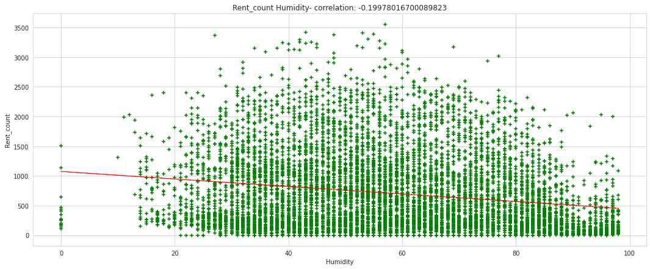
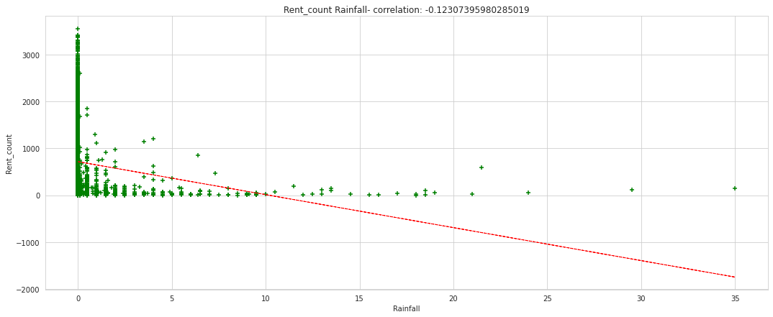
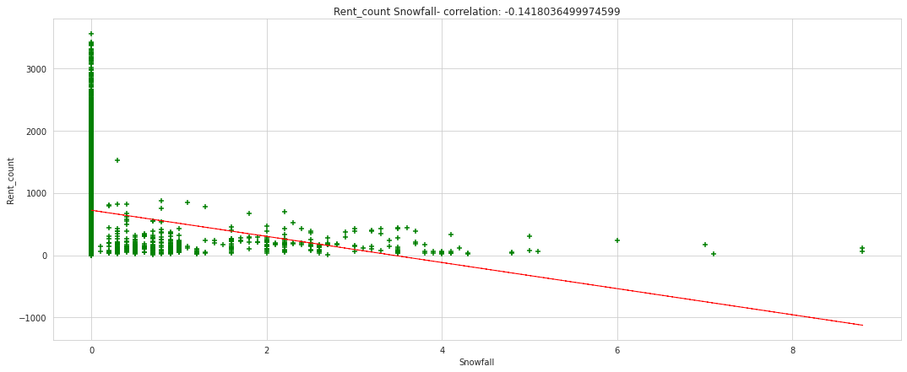
LINEAR ASSUMPETION: (NEGATIVE RELATIONSHIP)
Mean of residuals should be zero or close to 0 as much as possible. It is done to check whether our line is actually the line of “best fit”.
There should be homoscedasticity or equal variance in a regression model. This assumption means that the variance around the regression line is the same for all values of the predictor variable (X).
.There should not be multicollinearity in regression model. Multicollinearity generally occurs when there are high correlations between two or more independent variables.

Slide 14
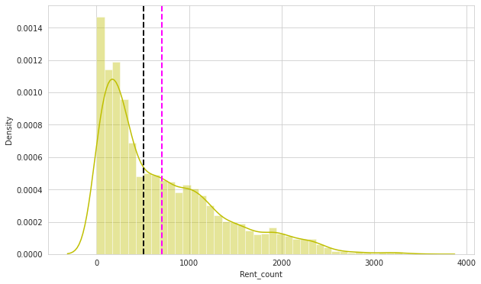
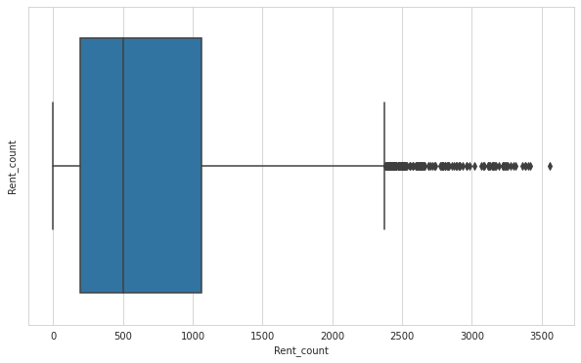
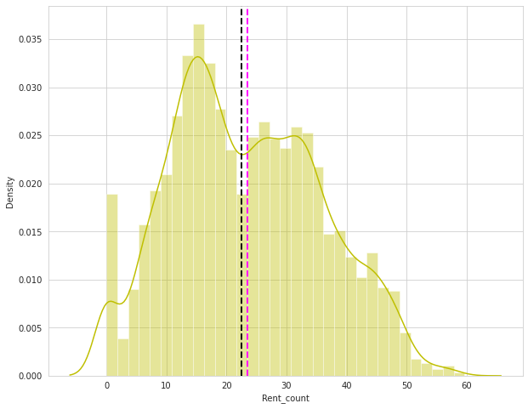
Distribution & skewness(removing outliers) : (dependent variable)
Before treatment Removing outlier After treatment
Outliers can have huge effect on the regression line.

Slide 15
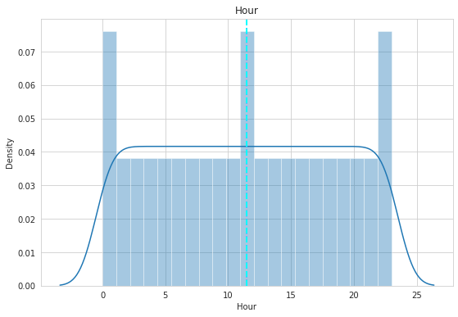
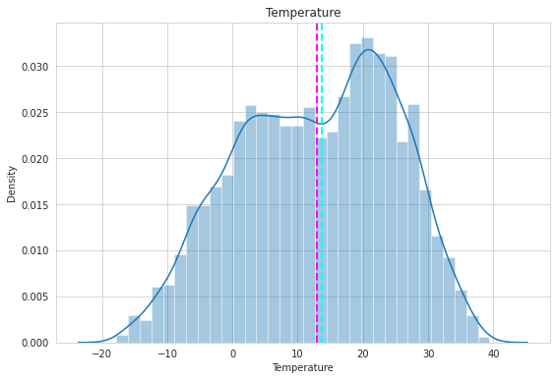
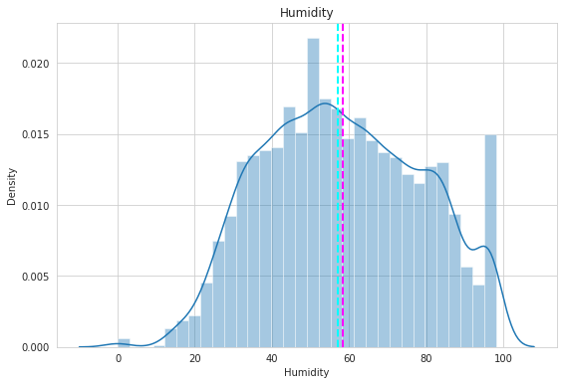
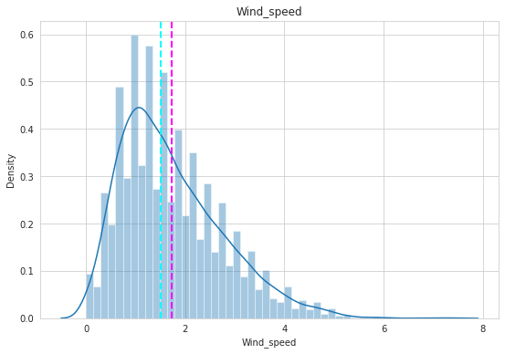
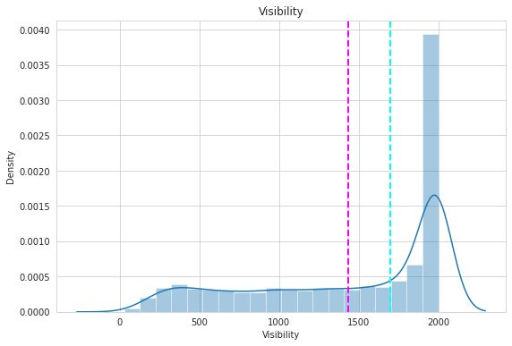
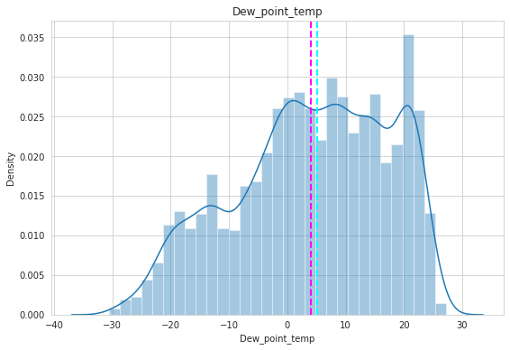
Distribution & skewness(removing outliers) : (Independent variable)

Slide 16
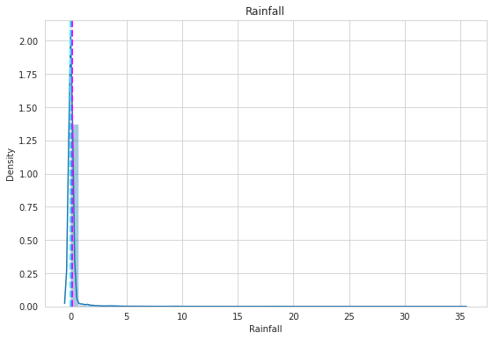
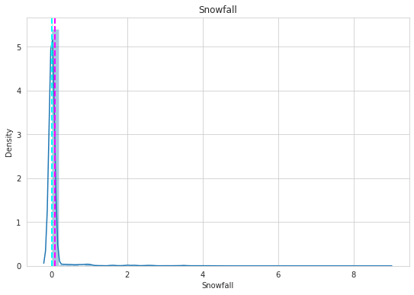
Lowvariance sprade of independedent variable

Slide 17
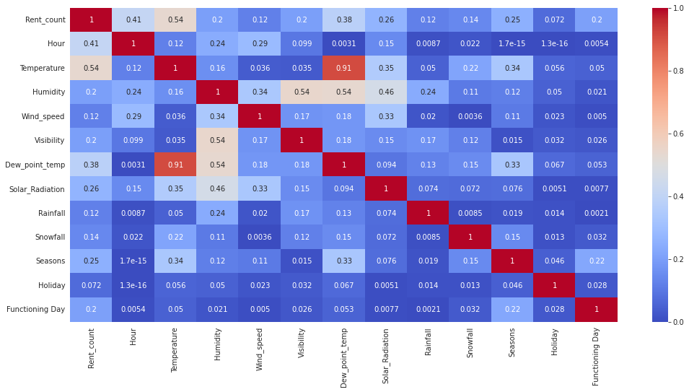
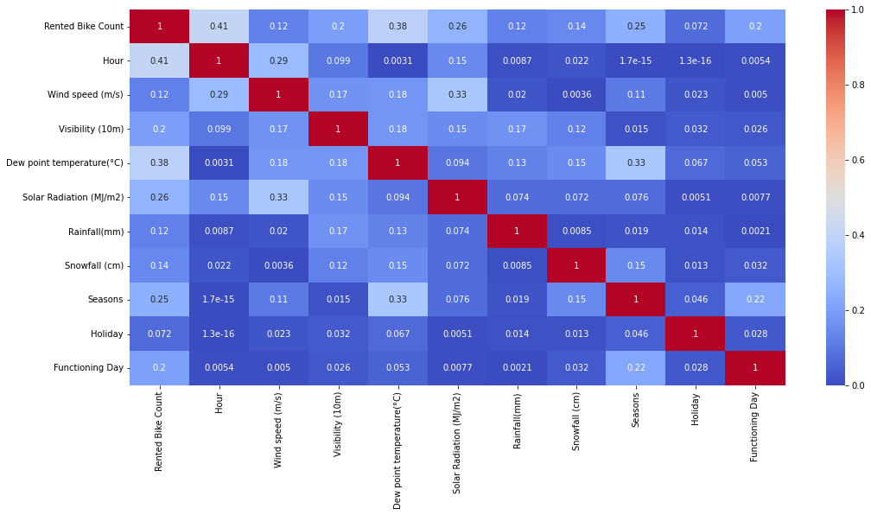
Treating Multicollinearity & feature selaction:
Multicollinearity occurs when independent variables in a regression model are correlated.
BEFRE TREATING VIF = 1/1-R*r AFTER TREATING
Droping constant feature using Variance Thresold
Feature selection with Pearson Corellation

Slide 18
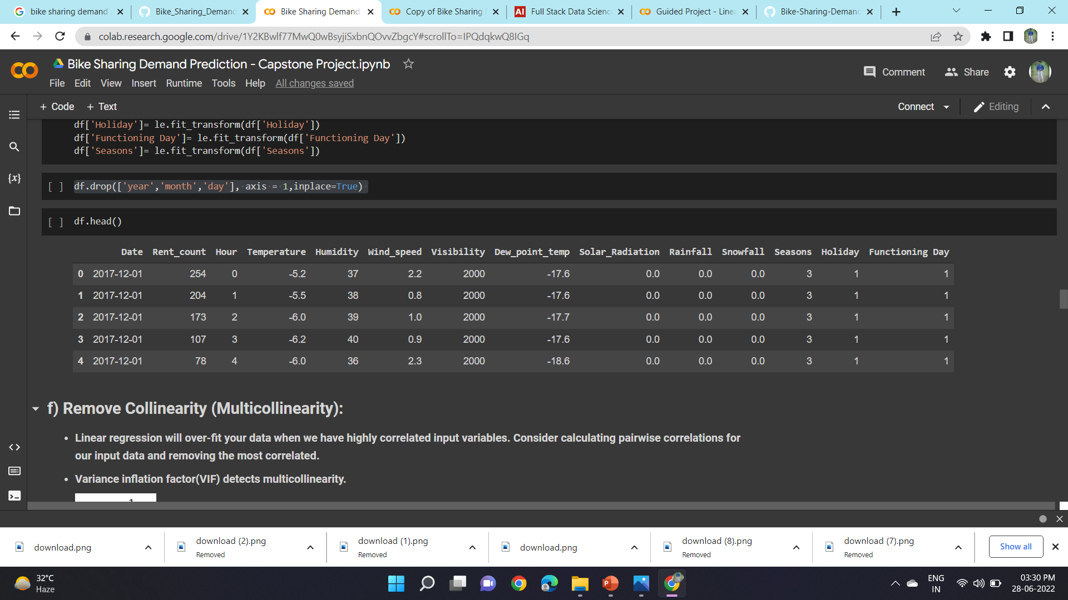
RESCALE INPUT:
Linear regression will often make more reliable predictions if you rescale input variables using standardization or normalization.
We use labelencoding & OneHotEncoding to do this.

Slide 19
Train test split :
input
from sklearn.model_selection import train_test_split
X_train, X_test, y_train, y_test = train_test_split( X,y , test_size = 0.2, random_state = 0)
output
the shape of X : (8760, 10)
the shape of y :(8760,)
the shape of X_train : (7008, 10)
the shape of y_train : (1752, 10)

Slide 20
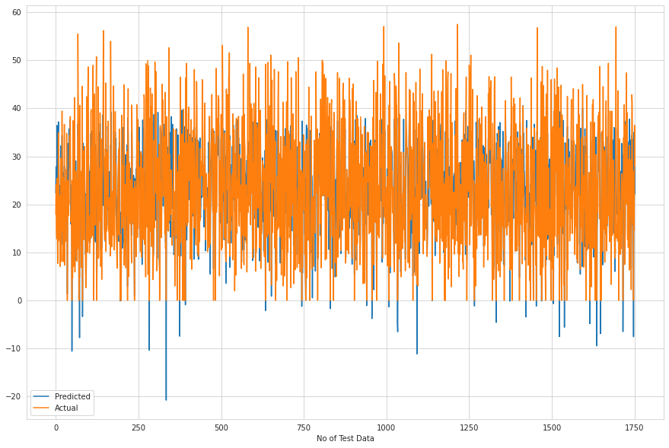
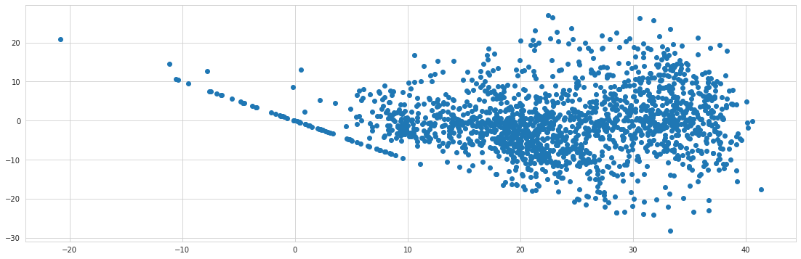
Models & Scores LINEAR REGRESSION
TRAIN SET METRICS
MSE : 63.53970367332495 RMSE : 7.971179565994292 MAE : 6.090480301800645 R2 : 0.588295094528132
Adjusted R2 : 0.5859303334398387
IMG
TEST SET METRICS
MSE : 65.48540902879017
RMSE : 8.092305544700482
MAE : 6.17686294216251
R2 : 0.5841833427090142
Adjusted R2 : 0.5817949644362342
HETROSCADACTICITY

Slide 21
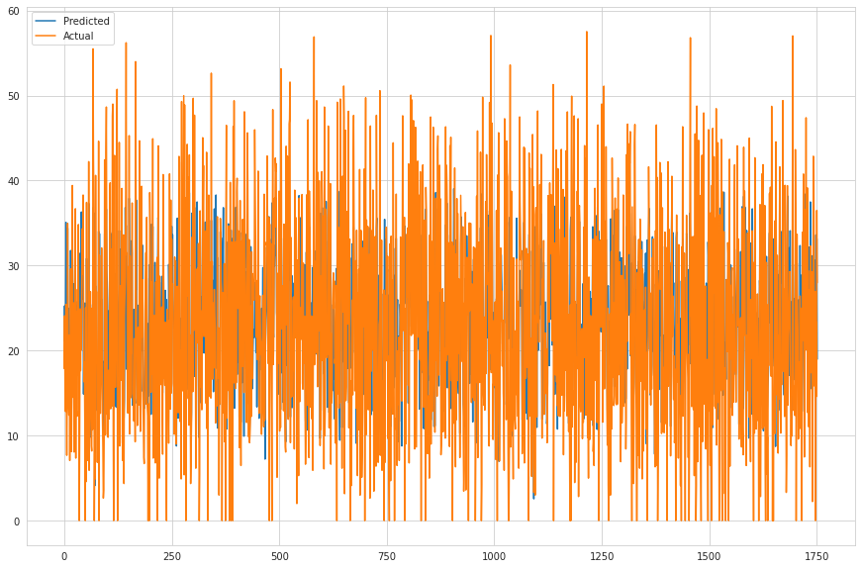
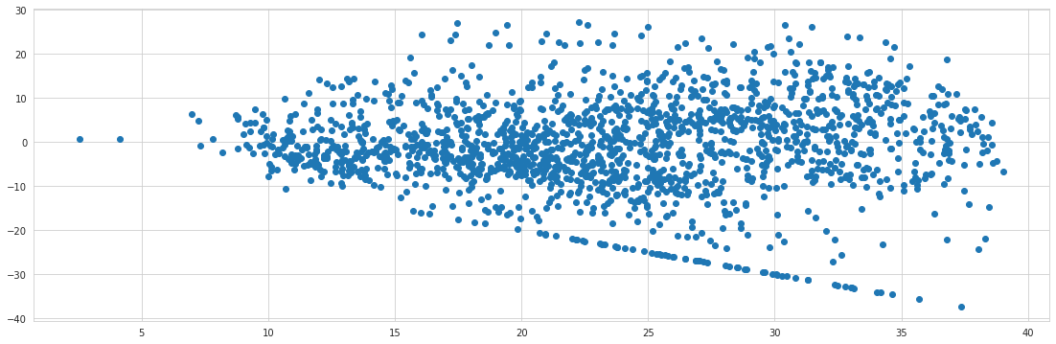
LASSO REGRESSION
TRAIN SET METRICS
MSE : 91.78336127708093 RMSE : 9.580363316549166 MAE : 7.260601220951637 R2 : 0.4052905837781736 Adjusted R2 : 0.40187467673496957
IMG
TEST SET METRICS
MSE : 100.36265740003871 RMSE : 10.018116459696339 MAE : 7.571432363869566 R2 : 0.36272117200066434 Adjusted R2 : 0.35906075368935275
HETROSCADACTICITY

Slide 22
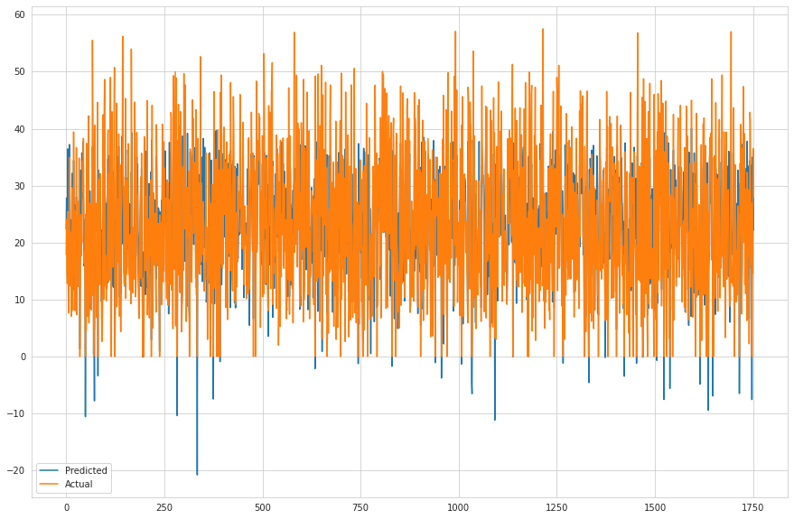
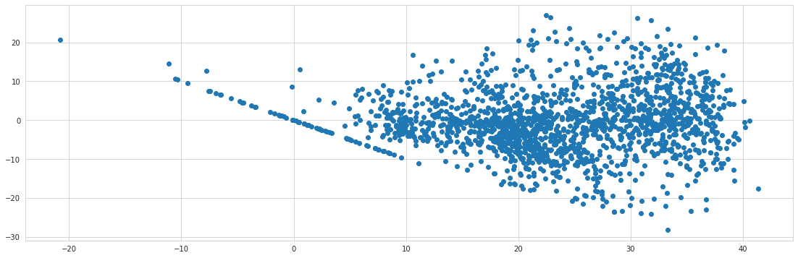
RIDGE REGRESSION
TRAIN SET METRICS
MSE : 63.53970938233556
RMSE : 7.971179924097534
MAE : 6.090510887344966
R2 : 0.5882950575366521
Adjusted R2 : 0.5859302962358861
IMG
TEST SET METRICS
MSE : 65.48612379629576
RMSE : 8.092349707983198
MAE : 6.176949920401537
R2 : 0.5841788041066092
Adjusted R2 : 0.5817903997648894
HETROSCADACTICITY

Slide 23
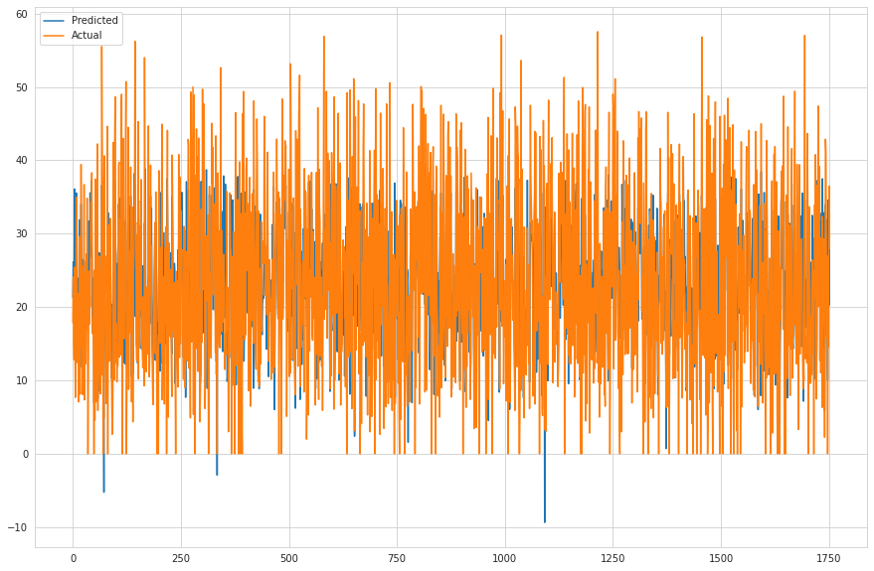
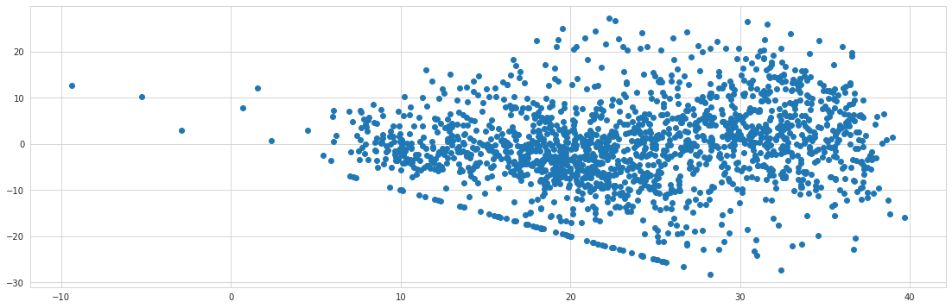
ELASTIC NET REGRESSION
TRAIN SET METRICS
MSE : 74.2190565932243
RMSE : 8.615048264126226
MAE : 6.580474515274741
R2 : 0.5190983288807387
Adjusted R2 : 0.5163361136531726
IMG
TEST SET METRICS
MSE : 79.251144063564
RMSE : 8.902311164162034
MAE : 6.7935603819766985
R2 : 0.49677422345320355
Adjusted R2 : 0.49388378246212483
HETROSCADACTICITY

Slide 24
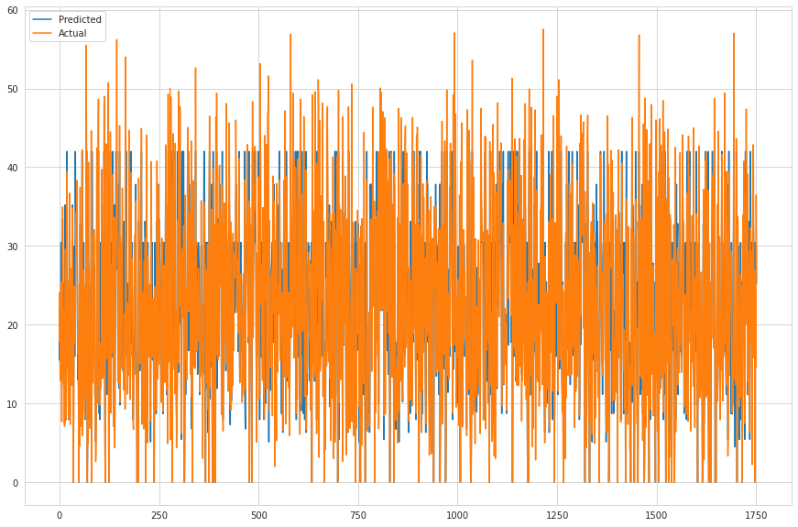
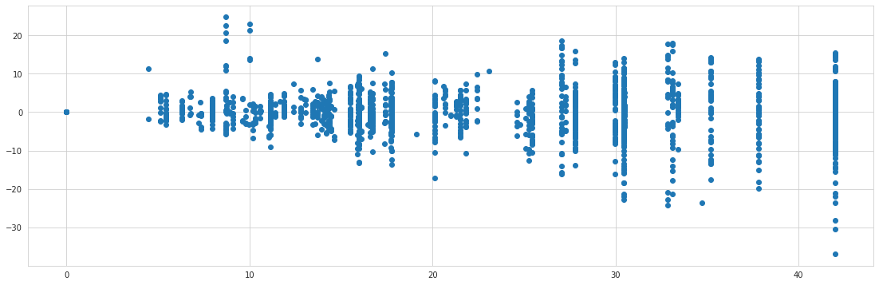
DECISSION TREE
TRAIN SET METRICS
Model Score: 0.8041347331111242 MSE : 30.228498258363036
RMSE : 5.498044948739782
MAE : 3.8710151183922235
R2 : 0.8041347331111242
Adjusted R2 : 0.8030097172185976
IMG
TEST SET METRICS
MSE : 34.34953467848406
RMSE : 5.8608476075124205
MAE : 4.0744463019040875
R2 : 0.7818886848026164
Adjusted R2 : 0.7806358914930392
HETROSCADACTICITY

Slide 25
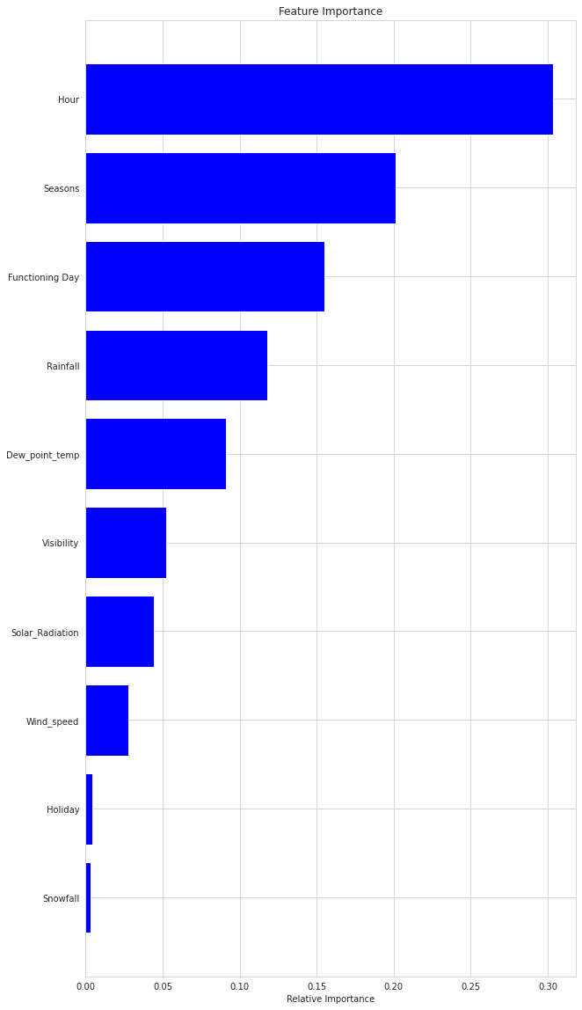
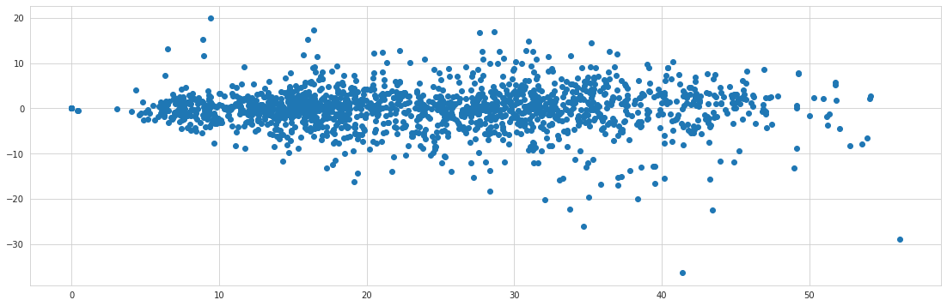
RANDOM FOREST
TRAIN SET METRICS
Model Score: 0.9803814302577617 MSE : 3.027795130319272
RMSE : 1.7400560710273885
MAE : 1.1786245342854724
R2 : 0.9803814302577617
Adjusted R2 : 0.9802687446188058
RANDOM FOREST REGRASSOR
TEST SET METRICS
MSE : 21.429009537458214 RMSE : 4.629147819789104 MAE : 3.1101490777146323 R2 : 0.8639309237420343 Adjusted R2 : 0.8631493667273418
HETROSCADACTICITY

Slide 26
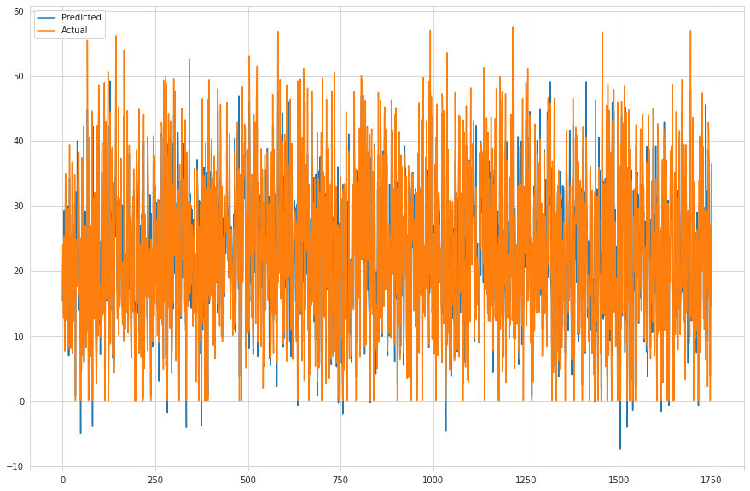
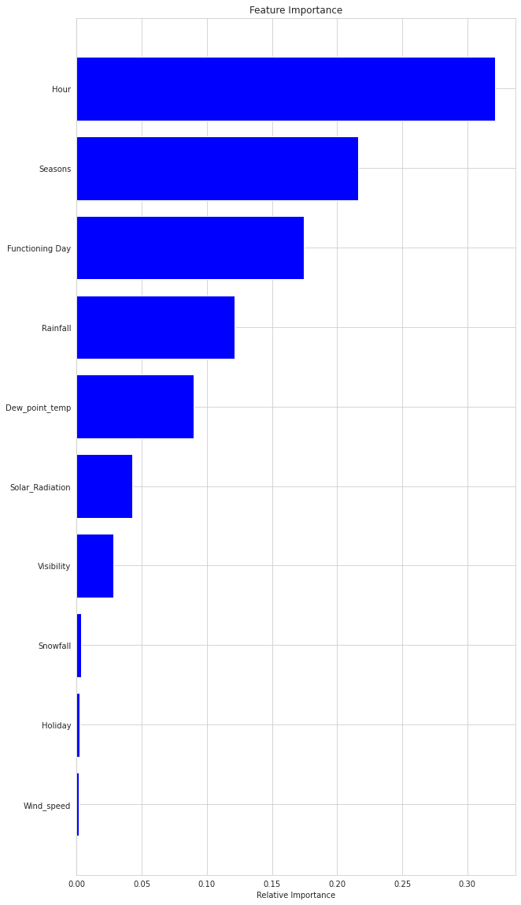
GRADIENT BOOSTING
TRAIN SET METRICS
Model Score: 0.8479069348445036 MSE : 23.472997679422324
RMSE : 4.844893980204554
MAE : 3.499138452562752
R2 : 0.8479069348445036
Adjusted R2 : 0.8470333388355691
IMG
TEST SET METRICS
MSE : 26.012656375342033
RMSE : 5.100260422306103
MAE : 3.6485695579279436
R2 : 0.8348258645449037
Adjusted R2 : 0.833877133152284
HETROSCADACTICITY

Slide 27
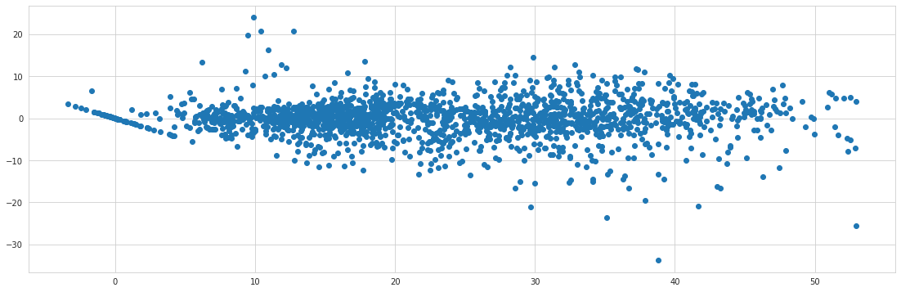
GREEDSEARCHCV
TRAIN SET METRICS
Model Score: 0.9080492041434136 MSE : 14.19105345504104
RMSE : 3.7671014659869515
MAE : 2.6468416332106677
R2 : 0.9080492041434136
Adjusted R2 : 0.9075210548277526
IMP FEATURE IMG
TEST SET METRICS
MSE : 20.352357558139644 RMSE : 4.511358726386059 MAE : 3.1042752480413944 R2 : 0.8707674058492033 Adjusted R2 : 0.8700251163940006
HETROSCADACTICITY

Slide 28
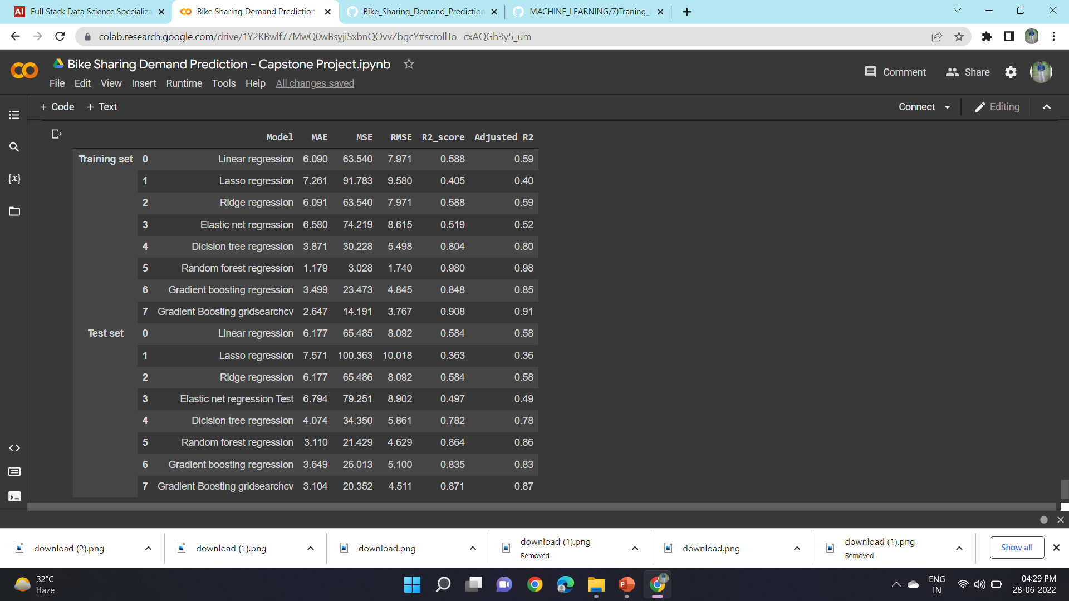
MAKING A DATA FRAME TO SAVE ALL THE OUTCOME:

Slide 29
CHALLENGES :
Large Dataset to Handle.
Needs to plt of Graphs to Analyse.
Carefully handles feature selection part as it effects the R2 score.
Carefully tunned Hyperparameters as it affects the R2 score
CONCLUSION :
The Rented Bike Count has been increased from 2017 to 2018.
No overfitting is seen.
Random forest & gradient boosting greedsearch cv gives the highest R2 score of 98% ,91% for train and 86% and 87% for Test set respectively
Feature Importance value for Random Forest, gradient boosting greedsearch cv are defferent
We can deploy this model
☺~THANK YOU ~☺

